Slide 1


Front End Engineering-II
G12-FE-PID-16
Team Details: Harshita Goyal:2410990338
Ananya Mahajan: 2410990919
Amisha Jindal: 2410990917
Faculty Coordinator : Md. Shadab Ansari
Chitkara University Institute of Engineering and Technology, Chitkara University, Punjab

Slide 2
Table of Contents
Introduction
1.1 Objectives
1.2 Significance
1.3 Scope
Problem Definition and Requirements
2.1 Problem Statement
2.2 Software Requirements
2.3 Data Requirements
Proposed Design / Methodology
3.1 System Design
3.2 Methodology
3.3 Workflow / Data Flow
3.4 Module Description
Results
Conclusion
References

Slide 3


Introduction
With increasing digitalization, most retail and business operations rely on automated systems for efficiency and accuracy. Manual management of shopping data—such as product details, stock information, and billing—often results in errors, delays, and difficulty in retrieving information.
To address these challenges, the project “Smart Shop – A Shopping Management System” has been developed. It provides an automated platform for storing and managing shopping records in a structured manner. The system improves operational efficiency by supporting quick billing, product updates, and systematic inventory management. It uses modern programming techniques and database concepts to create a smooth workflow that benefits store administrators and users.

Slide 4
1.2 Objectives
The primary objectives of Smart Shop are:
To develop an automated platform for managing shopping activities.
To simplify product entry, update, deletion, and search operations.
To maintain accurate stock and inventory records.
To automate billing to reduce human errors.
To provide fast and accurate retrieval of data.
To create a user-friendly interface that improves the shopping management process.
To replace manual paperwork with a digital, systematic record system.

Slide 5
1.2 Significance
The significance of Smart Shop lies in its ability to modernize store management through automation. It helps prevent errors that occur in manual billing or record keeping. The system ensures:
Greater accuracy in product and billing records
Enhanced speed of operations
Better organization of shopping data
Quick decision-making through digital tracking
Reduced workload for shopkeepers
Improved customer satisfaction through faster processing
Smart Shop supports smooth business operations and ensures long-term data reliability.

Slide 6
1.3 Scope
The scope of Smart Shop – A Shopping Management System includes:
Product management (add, update, delete)
Billing and purchase calculation
Maintaining stock/inventory levels
Displaying available items
Organizing data in a structured format
Providing easy navigation for users
The system is suitable for small businesses, shops, and educational demonstrations. Future upgrades may include online payment integration, customer accounts, or advanced reporting.

Slide 7
2. Problem Definition & Requirements
2.1 Problem statement
Retail stores often rely on manual methods for recording product details, preparing bills, and maintaining inventory. Such methods are slow, difficult to manage, and prone to mistakes. There is no efficient way to update stock or verify product details instantly. This creates inconvenience for shopkeepers and reduces the overall efficiency of the shop.
The Smart Shop system aims to solve these issues by automating the entire process. The system offers an easy and accurate way to handle product records, generate bills, and maintain inventory seamlessly.

Slide 8
2.2 Software Requirements
Programming Languages Used:
Java – Backend logic, data processing, file handling
JavaScript – Frontend functionality
React.js – Component-based frontend framework for UI
HTML5 – Webpage structure
CSS3 – Styling and layout
IDE / Code Editors:
VS Code – For React, JavaScript, HTML, CSS
IntelliJ / Eclipse / VS Code – For Java development
Framework / Libraries:
React.js (Frontend framework)
Node.js + npm (For running React and managing packages)
Java I/O Libraries (For file handling in Java)

Slide 9
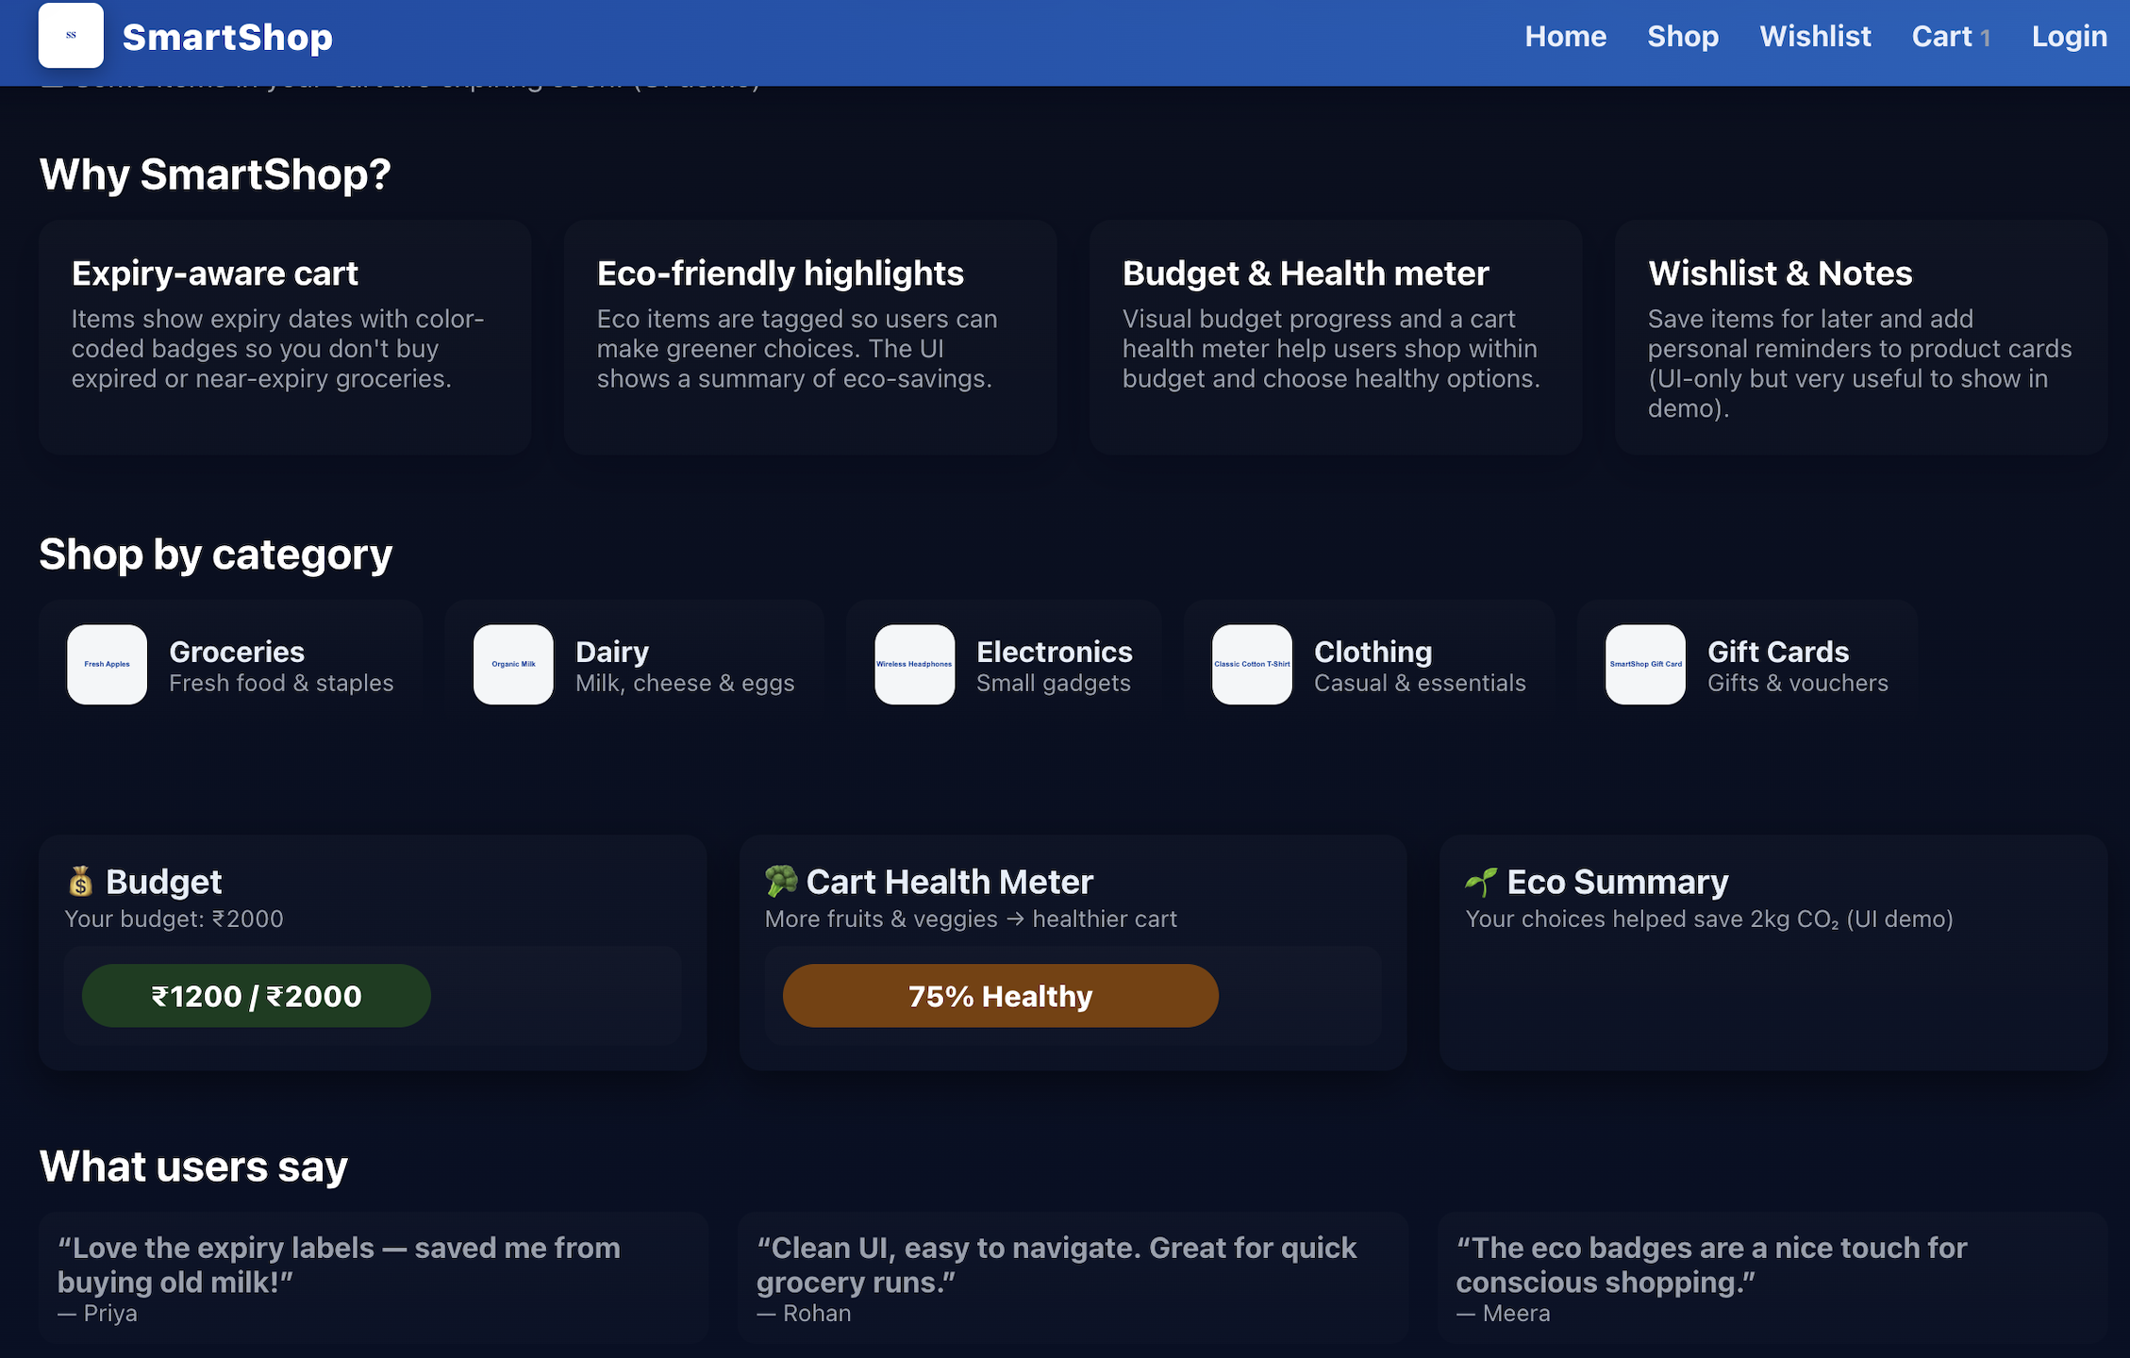
2.3 Data Requirements
Smart Shop uses structured data such as:
Product name
Product ID
Price
Quantity / stock
Billing details

Slide 10
Proposed Design / Methodology
3.1 System Design
The Smart Shop system is designed using a modular approach. Each module focuses on a specific part of the shopping management process, ensuring simplicity and clarity.
The system architecture includes:
Input Module: For entering product and billing details
Processing Module: For calculations and logic
Inventory Module: For stock management
Display Module: For showing product lists and results
Storage Module: For maintaining records
This structure allows efficient workflow and easy maintenance.

Slide 11
3.2 Methodology
The methodology used in developing Smart Shop includes:
Requirement Analysis – Understanding shop management needs
System Planning – Selecting language, tools, and structure
Design Phase – Creating diagrams and logical flow
Development – Writing code for each module
Testing – Checking for accuracy and correcting errors
Evaluation – Ensuring the system meets objectives
This step-by-step approach ensures reliability and smooth functionality.

Slide 12
3.3 Workflow / Data Flow
The workflow of Smart Shop operates in the following manner:
User enters product or billing data
System validates the input
Data is processed to update stock or generate billing
Final output is displayed to the user
Records are stored for future retrieval
The flow ensures accuracy and smooth operation.

Slide 13
3.4 Module Description
Product Module: Allows adding, viewing, editing, and removing product details.
Inventory Module: Manages stock levels and updates quantities automatically.
Billing Module: Calculates total cost, generates final bill, and updates stock.
Display Module: Shows all required details clearly.
Storage Module: Saves and retrieves product records for long-term use.
Each module works together to handle shopping management efficiently.

Slide 14
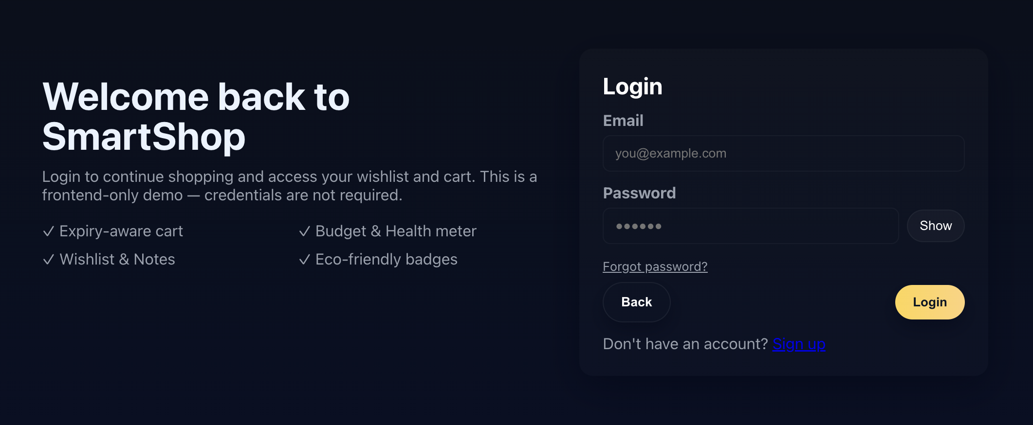
Result
The Smart Shop system successfully performs all required shopping management activities. The results include:
1. Login Page

Slide 15
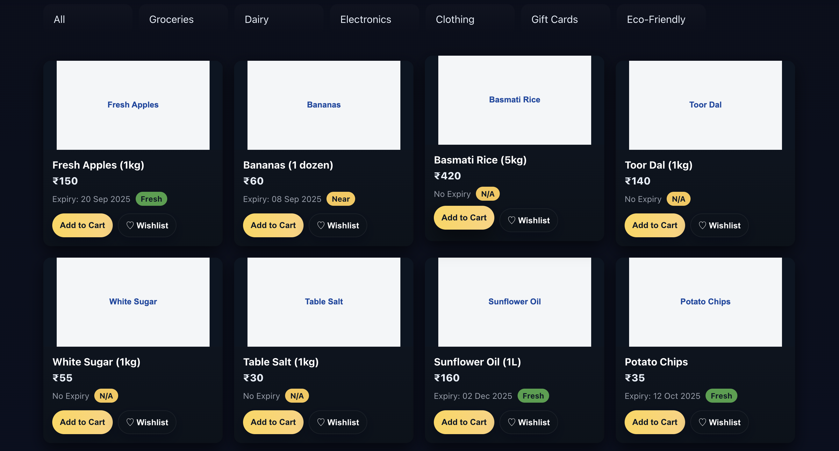
2. Items

Slide 16
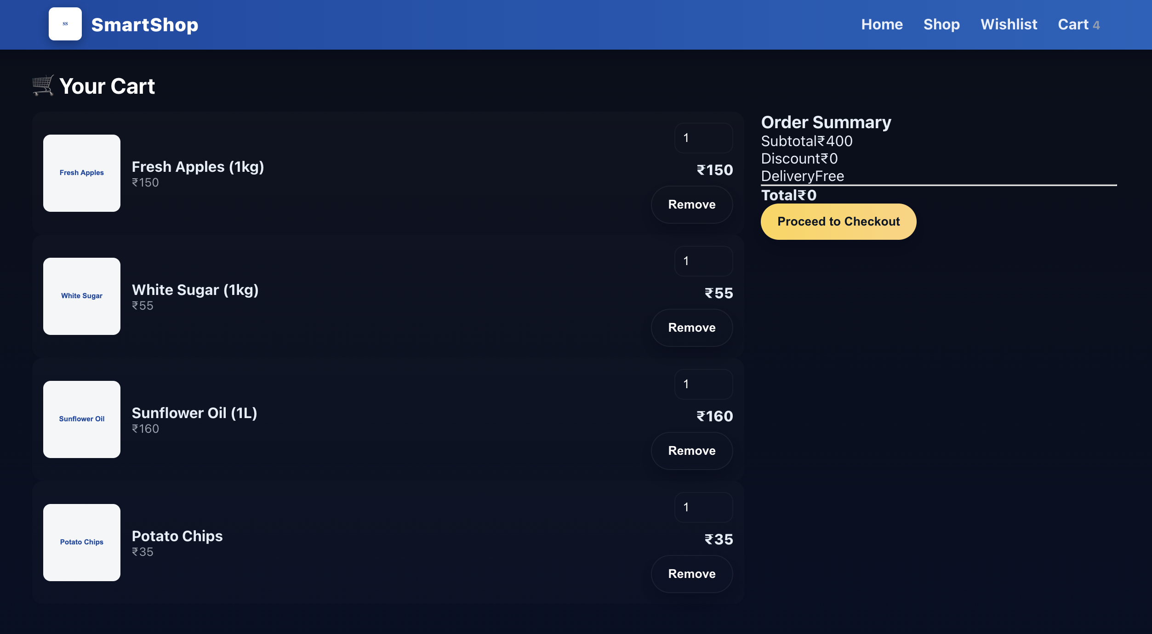
3. Wishlist
4. Cart

Slide 17
Conclusion
The Smart Shop project successfully demonstrates how modern retail management can be simplified using a combination of Java for backend processing and React, JavaScript, HTML, and CSS for an interactive frontend interface. Through this project, essential shop operations such as product listing, inventory tracking, billing, and user interaction were streamlined into a structured and user-friendly system.
The application provides a reliable and efficient method for managing store activities by integrating file-based storage, intuitive UI components, and modular Java logic. It highlights how hybrid technologies can work together to build scalable, maintainable, and visually appealing software solutions.
Overall, the project achieves its objectives by offering a practical solution that enhances productivity, reduces manual errors, and provides an organized workflow for small to medium retail environments. The Smart Shop system can be further expanded in the future by introducing a database, adding authentication, implementing cloud storage, or integrating payment gateways. This demonstrates the potential for scalability and real-world applicability of the project.

Slide 18
References/Link Used
Oracle. Java SE Documentation.
MDN Web Docs. HTML, CSS, and JavaScript Guides.
ReactJS. Official React Documentation.
Visual Studio Code. Editor Documentation.
W3Schools. Web Development Tutorials.
Mozilla Developer Network (MDN). CSS: Cascading Style Sheets – Documentation.

Slide 19


